Slide 1

AtliQ Hospitality Domain
Bhushan H. Gaidhane
bgaidhane815@gmail.com

Slide 2
Introduction
AtliQ Grands owns multiple five-star hotels across India. They have been in the hospitality industry for the past 20 years.
Due to strategic moves from other competitors and ineffective decision-making in management,
AtliQ Grands are losing its market share and revenue in the luxury/business hotels category.
As a strategic move, the managing director of AtliQ Grands wanted to incorporate “Business and Data Intelligence” to regain their market share and revenue.
However, they do not have an in-house data analytics team to provide them with these insights.

Slide 3

AtliQ Business Understanding
Bangalore
Delhi
Mumbai
Hyderabad
AtliQ Bay
AtliQ Blu
AtliQ City
AtliQ Exotics
AtliQ Grands
AtliQ Palace
AtliQ Bay
AtliQ Blu
AtliQ City
AtliQ Exotics
AtliQ Grands
AtliQ Palace
AtliQ Bay
AtliQ Blu
AtliQ City
AtliQ Exotics
AtliQ Grands
AtliQ Palace
AtliQ Bay
AtliQ Blu
AtliQ City
AtliQ Exotics
AtliQ Grands
AtliQ Palace
Luxury
Business
Luxury
Business
Luxury
Business
Luxury
Business
Category
Various Palatform

Slide 4
Dataset Details
AtliQ are Provided 3 Months booking details data of all the AtliQ Hotels.
Dataset Contains 5 Excel Files.
Dim_date
Dim_hotels
Dim_rooms
Fact_aggregated_booking
Fact_bookings
Metric list excel file
Mock-up Dashboard

Slide 5
Expected Outcomes After This Analysis
Regain their market share in the luxury/business hotels category.
Understanding the revenue trend by week/month/day.
To get Insights where business is falling and what can be done to tackle them.

Slide 6
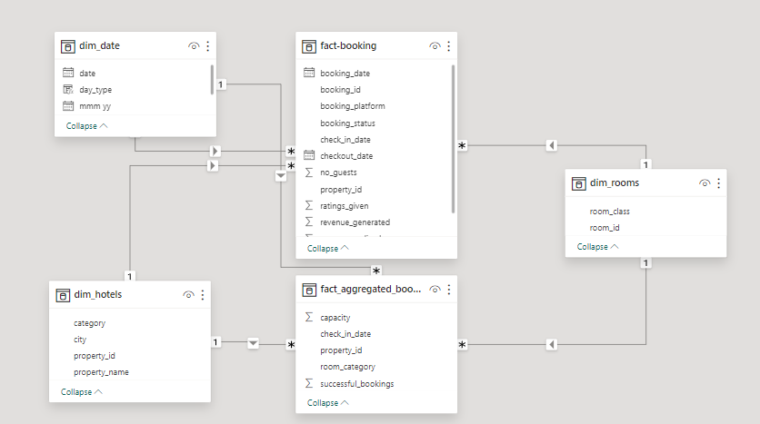
Cleaning
Data Modeling
Data Validating

Slide 7
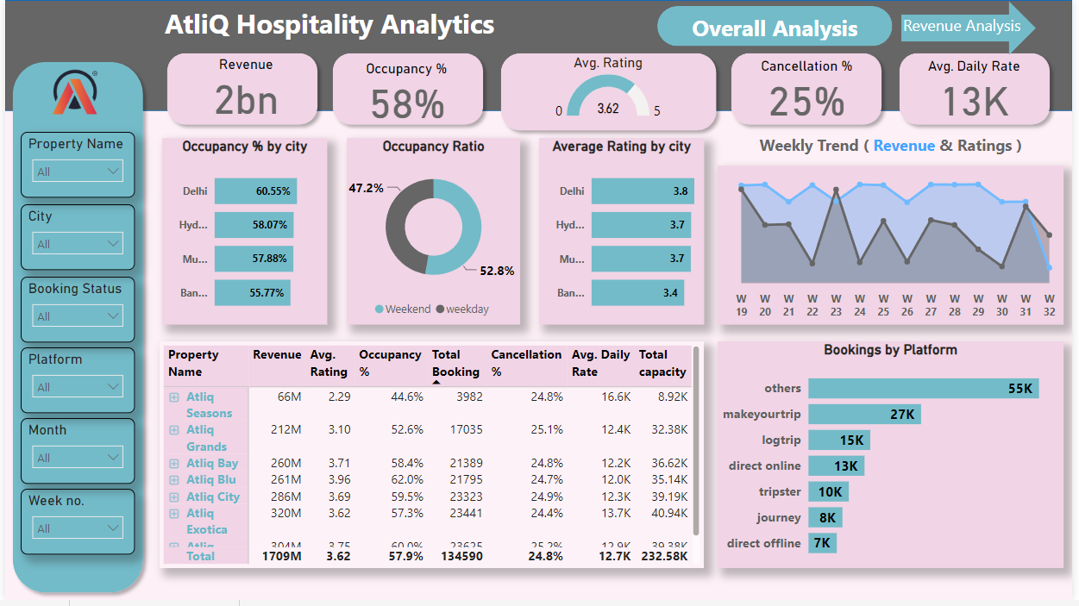
Overall Analysis

Slide 8
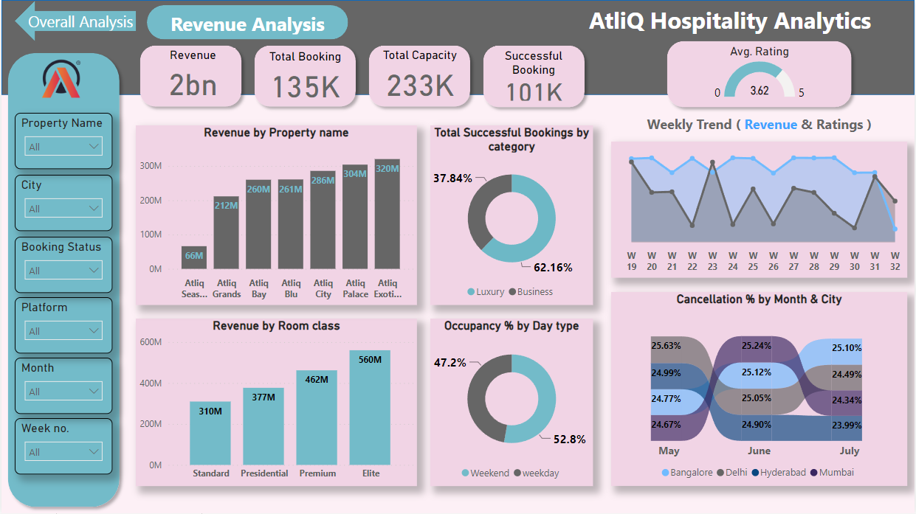
Revenue Analysis

Slide 9
Thank You
Bhushan H. Gaidhane
bgaidhane815@gmail.com

